Slide 2
Compare & contrast
John: Birth foretold Luke 1:5-25 Miracle Birth Great Prophet
Jesus: Birth foretold Luke 1:26-45 Virgin Birth Great
Mary’s Song Luke 1:46-56 Mary is Blessed God the Saviour
John: Birth Luke 1:57-66 His Name Great Prophet
Zechariah’s Song Luke 1:67-80 Spirit Filled God the Saviour
Jesus: Birth Luke 2:1-20 God in History Great
When Jesus comes to town

Slide 3
When Jesus comes to town

Slide 4
³¹ You will conceive and give birth to a son, and you are to call him Jesus.³² He will be great and will be called the Son of the Most High. The Lord God will give him the throne of his father David,³³ and he will reign over Jacob's descendants forever; his kingdom will never end." (Luke 1:31-33 NIV)
When Jesus comes to town

Slide 5
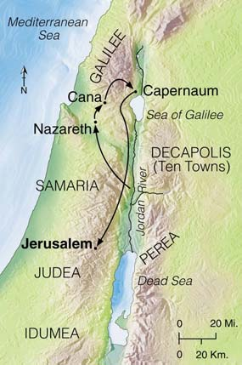
Map of northern Israel
When Jesus comes to town

Slide 6
³¹ You will conceive and give birth to a son, and you are to call him Jesus.³² He will be great and will be called the Son of the Most High. The Lord God will give him the throne of his father David,³³ and he will reign over Jacob's descendants forever; his kingdom will never end." (Luke 1:31-33 NIV)
When Jesus comes to town

Slide 7
When Jesus comes to town

Slide 8
⁶ to the praise of his glorious grace, which he has freely given us in the One he loves. (Eph 1:6 NIV)
When Jesus comes to town

Slide 9
When Jesus comes to town

Slide 10
Compare & contrast
Adam Genesis 2-3 Created from dust
Jesus Luke 1-2 Created from God and woman
Adam Genesis 3 Corrupt nature leads to sin
Jesus Luke 1-2 God in the flesh resists sin
Adam Genesis All Condemned in Adam
Jesus Gospels All Alive by faith in Jesus
When Jesus comes to town

