Slide 2

Pergamum

Slide 3

Repent

Slide 4
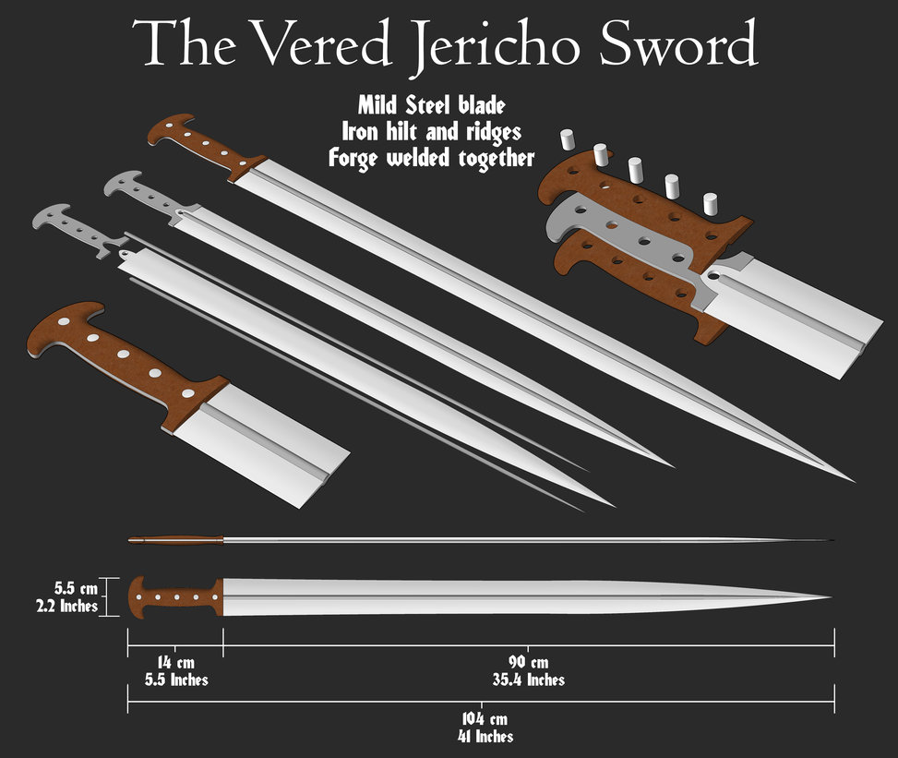
Rev 1:16

Slide 5
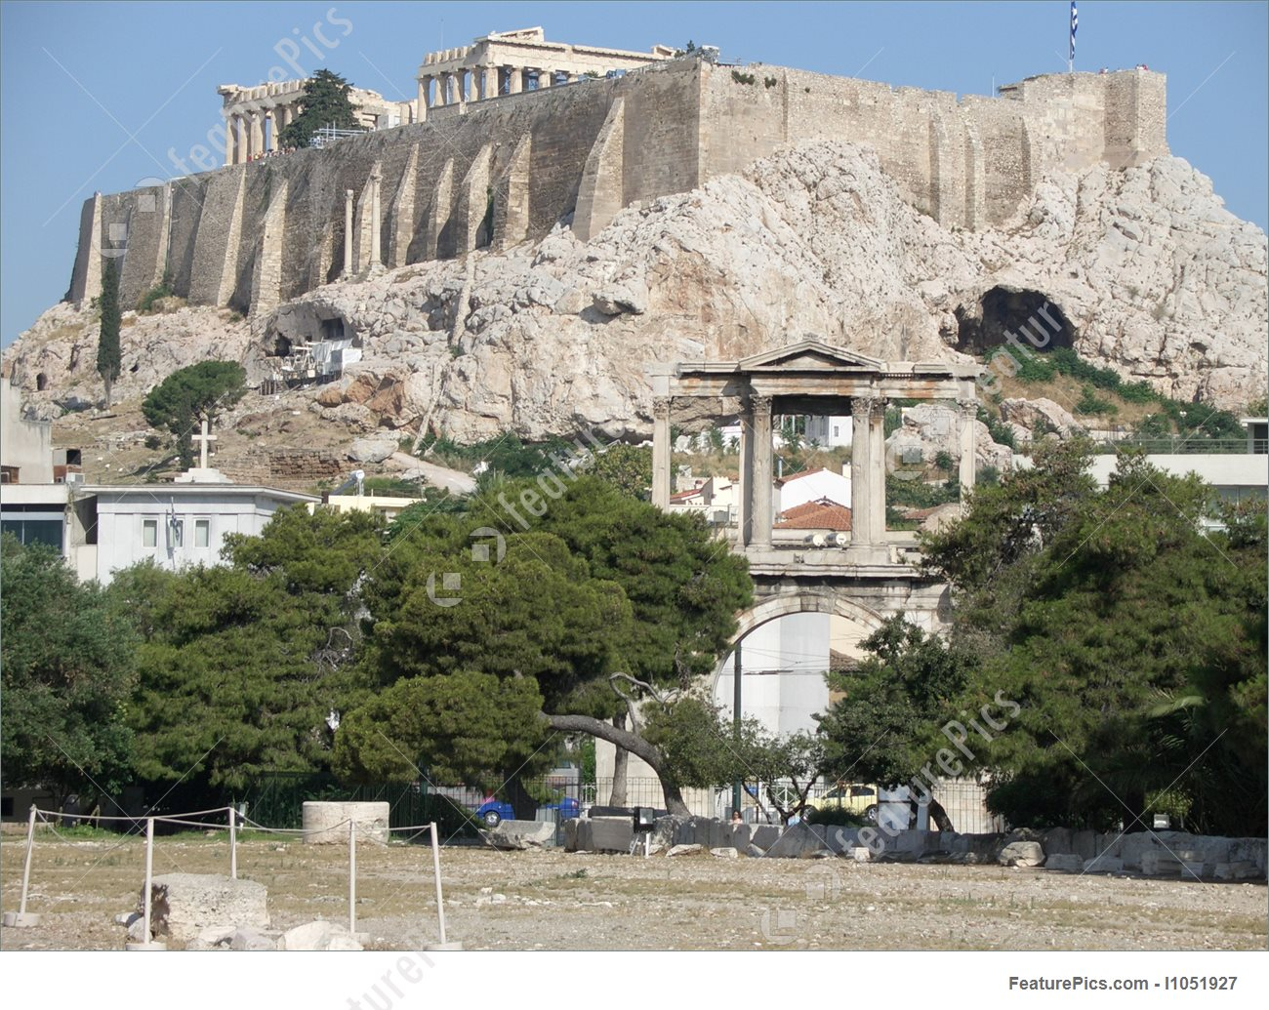
Rome Acropolis

Slide 6
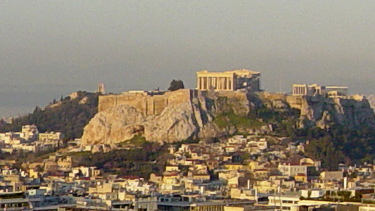

Slide 7
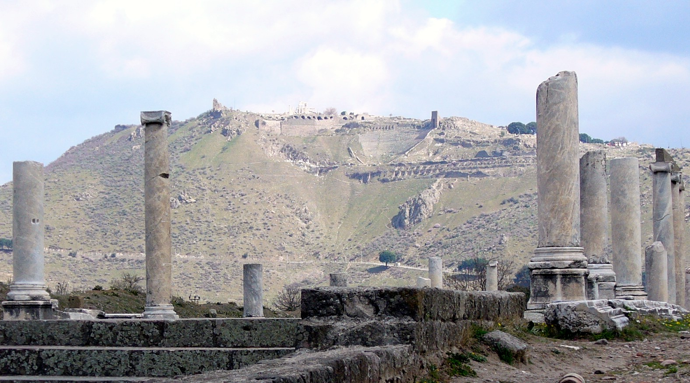
Pergamum Acropolis

Slide 8
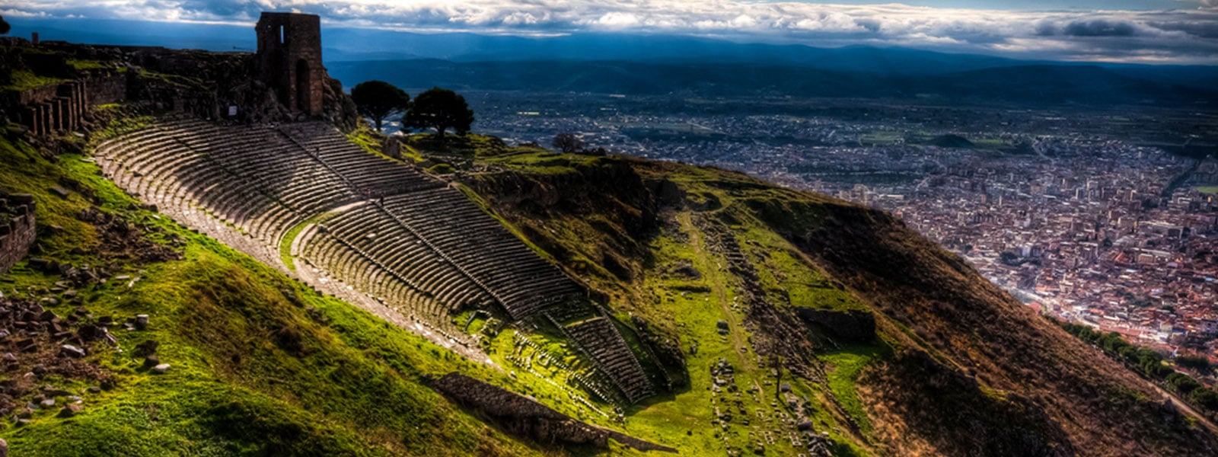
Pergamum Acropolis

Slide 9
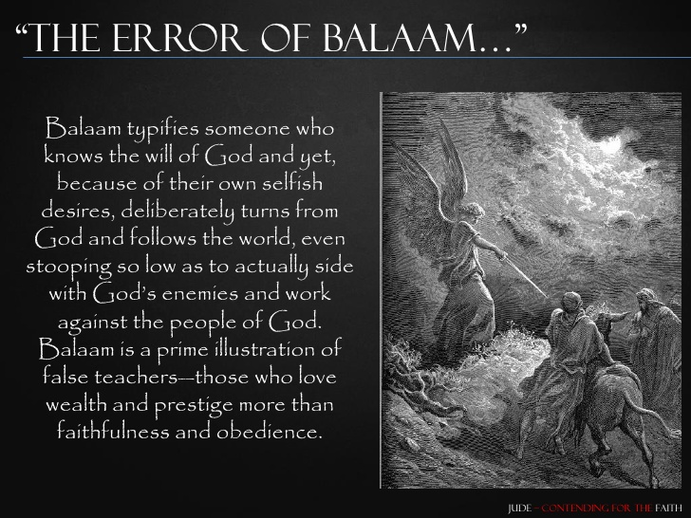

Slide 11

Adiaphora

