Slide 1
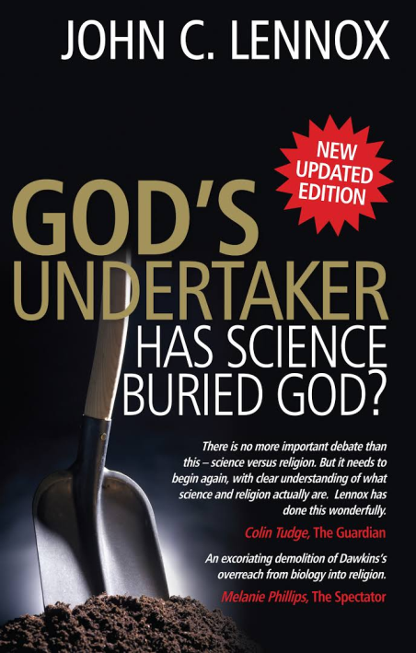
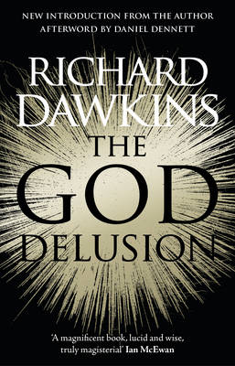
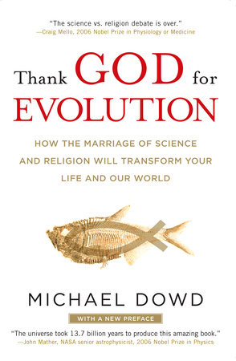
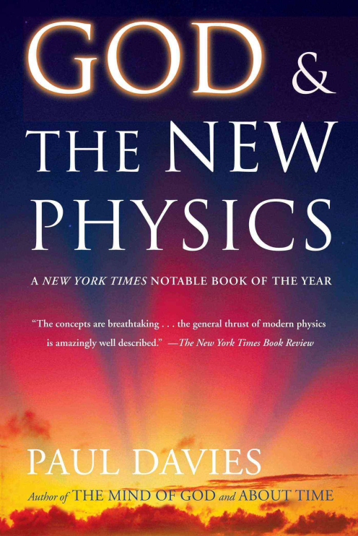
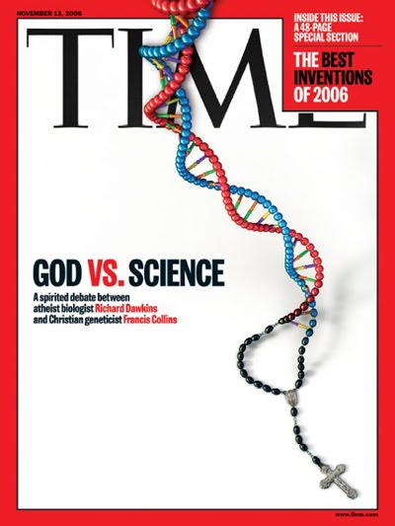
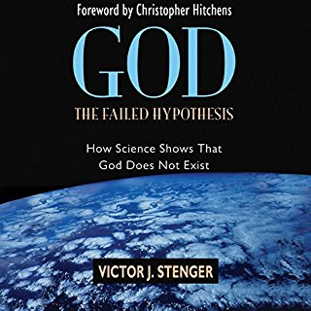
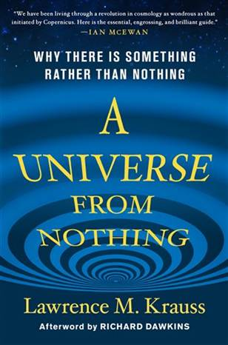
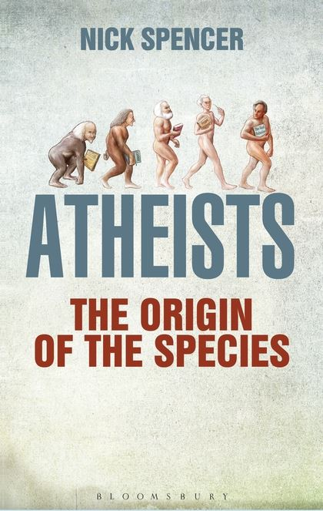
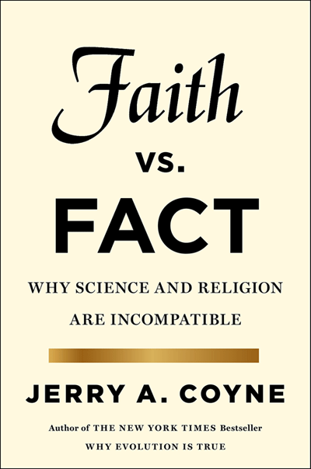
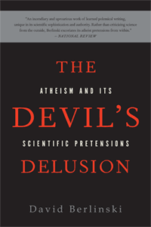
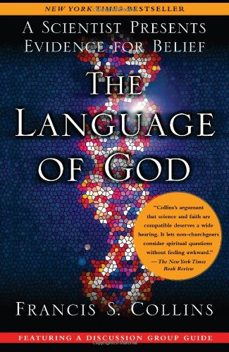

Slide 2
Factual
Blind
Enemy of reason
Unbiased
Authoritative answer to everything
No Longer necessary and harmful
Notes:
Common view
Science: unbiased
Religion: blind faith

Slide 3
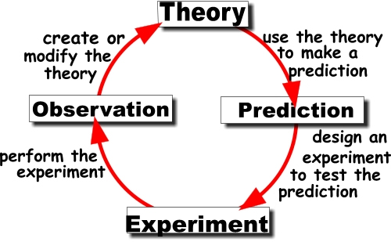
What sort of questions can science answer?
What
How

Slide 4
What sort of questions can science NOT answer?
Who
Why

Slide 5
What sort of questions can science NOT answer?
My Wife
Wants a cup
of tea

Slide 6
Competing explanations?
NOT contradictory
But complimentary

Slide 7
Is there anything wrong with Science?

Slide 8
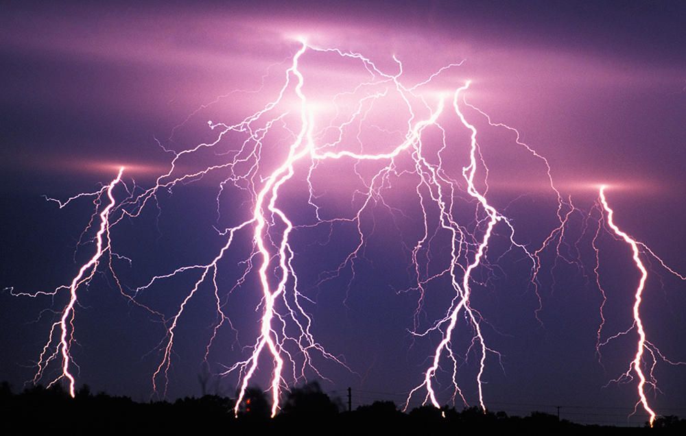
His glory is revealed in his creation.

Slide 9
Famous Scientists who believed in God
Galileo
Kepler
Blaise Pascal
Robert Boyle
Michael Faraday
Charles Babbage
Gregor Mendel
Lois Pasteur
Lord Kelvin
James Clark Maxwell
Notes:
Galileo - His belief in God gave him his passion for science.
Kepler – famous phrase “Thinking God’s thoughts after him.” Motivated by discovering the rational order in which an intelligence has imposed upon the natural world.

Slide 10
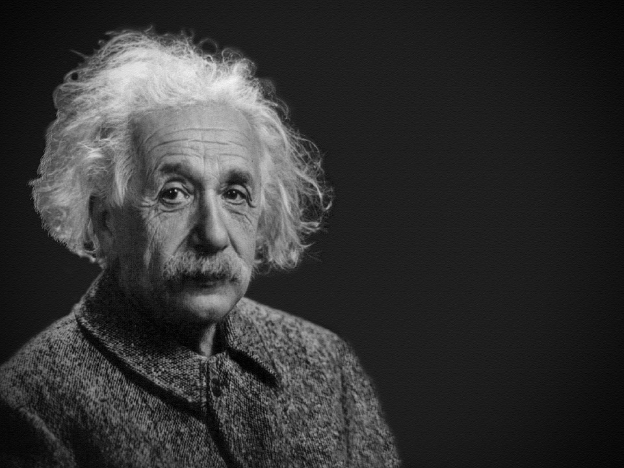
“The most incomprehensible thing about the universe is that it is comprehensible.”
Notes:
Einstein understood that if a Universe existed, there is no reason it should be rational and intelligible. It would be chaotic. Why is it that we can describe natural behaviours in terms of laws and patterns?

Slide 11
Christians who are respectable scientists
Francis Collins – Former Director of Human Genome Project
Professor Bill Phillips – Nobel Prize in Physics 1997
Arthur Schawlow – Nobel Prize in Physics 1981
John Charlton Polkinghorne, KBE, FRS, Theoretical Physicist
Sir Brian Heap, former vice president of the Royal Society
Sir John Haughton, former director of the British Meterological Office
Professor Paul Shellard, Director of Centre for Theoretical Cosmology, University of Cambridge

Slide 12
Naturalism vs Theism
Scientism
The new atheism

Slide 13
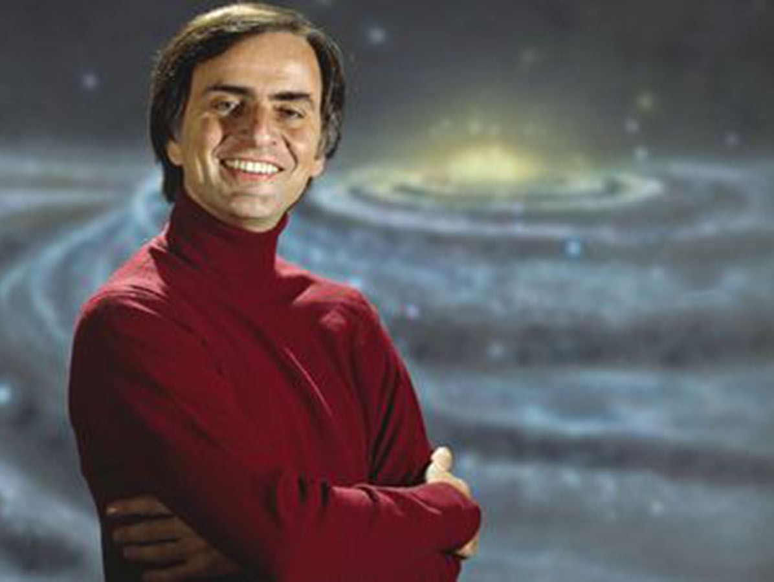
Cosmologist – Carl Sagan
The cosmos is all that is, or ever was, or ever will be.

Slide 14
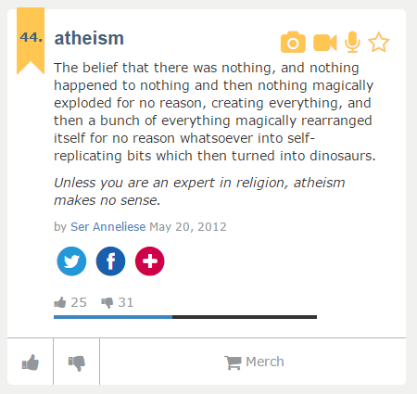
From Urban Dictionary

Slide 15
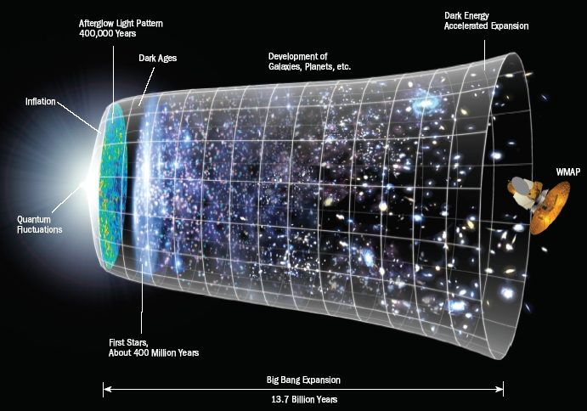

Slide 16
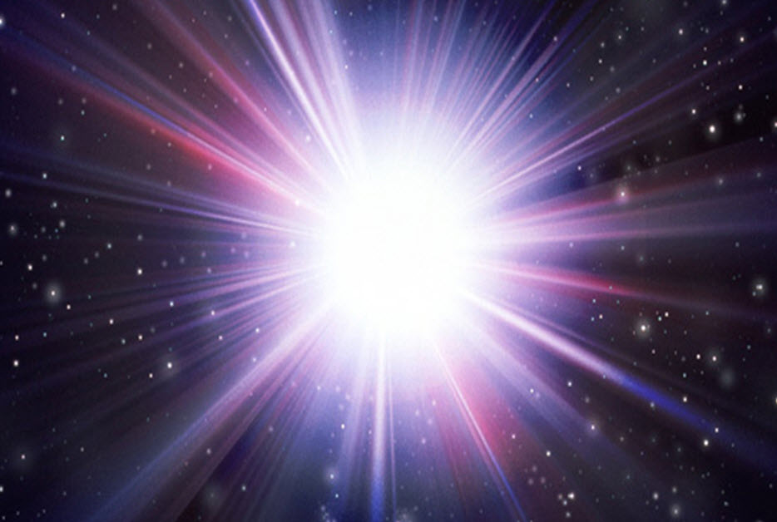
And
God
said,
“Let there be light”.
And there was light.
Genesis 1:3

Slide 17
Hebrews 11:3
3 By faith we understand that the universe was formed at God's command, so that what is seen was not made out of what was visible.

Slide 19
Job 9:8
He alone stretches out the heavens _ and treads on the waves of the sea.
Psalm 104:2
The LORD wraps himself in light as with a garment; _ he stretches out the heavens like a tent
Isaiah 40:22
He sits enthroned above the circle of the earth, _ and its people are like grasshoppers. _He stretches out the heavens like a canopy, _ and spreads them out like a tent to live in.
Isaiah 42:5
This is what God the LORD says _the Creator of the heavens, who stretches them out, _ who spreads out the earth with all that springs from it, _ who gives breath to its people, _ and life to those who walk on it
Isaiah 44:24
This is what the LORD says _ your Redeemer, who formed you in the womb: I am the LORD, _ the Maker of all things, _ who stretches out the heavens, _ who spreads out the earth by myself,
Isaiah 45:12
It is I who made the earth _ and created mankind on it. _My own hands stretched out the heavens; _ I marshaled their starry hosts.
Isaiah 48:13
My own hand laid the foundations of the earth, _ and my right hand spread out the heavens; _when I summon them, _ they all stand up together.
Isaiah 51:13
that you forget the LORD your Maker, _ who stretches out the heavens _ and who lays the foundations of the earth, _that you live in constant terror every day _ because of the wrath of the oppressor, _ who is bent on destruction?
Jeremiah 10:12
But God made the earth by his power; _ he founded the world by his wisdom _ and stretched out the heavens by his understanding.
Jeremiah 51:15
He made the earth by his power; _ he founded the world by his wisdom _ and stretched out the heavens by his understanding.
Zechariah 12:1
The LORD, who stretches out the heavens, who lays the foundation of the earth, and who forms the human spirit within a person, declares: 2 I am going to make Jerusalem a cup that sends all the surrounding peoples reeling. Judah will be besieged as well as Jerusalem.

Slide 20
Psalm 19:1-6
1 The heavens declare the glory of God; the skies proclaim the work of his hands.

Slide 21
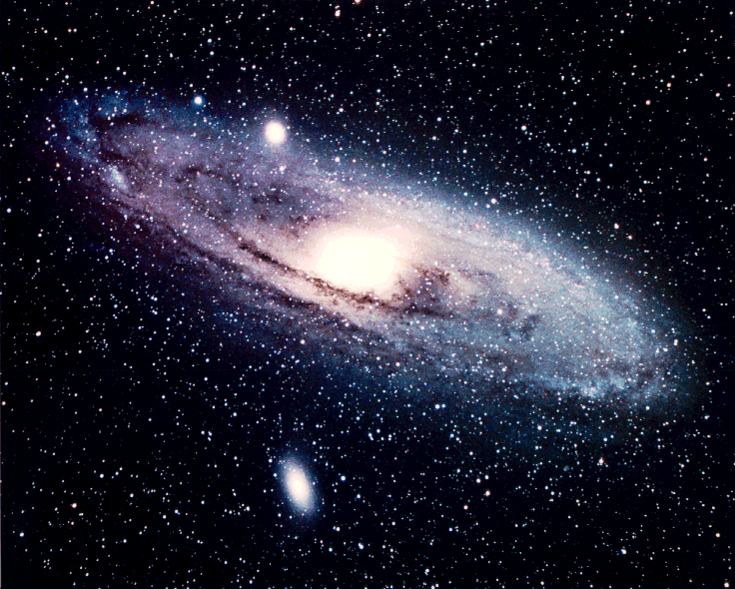

Slide 22
What is a light year?
More holidays
Fewer bills

Slide 23
What is a light-year?
A light year (ly) is a unit of distance.
It is the distance light travels in one year.
The speed of light is 300 000 km/s
How many km is one ly?
300 000 x 60 x 60 x 24 x 365¼
9.46 x 10¹² km

Slide 24
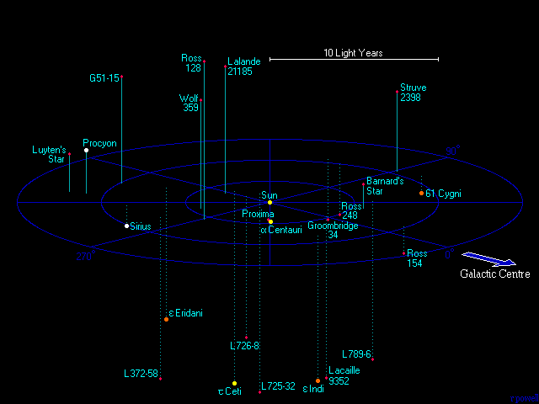
Stars within 12 light years of the Sun

Slide 25
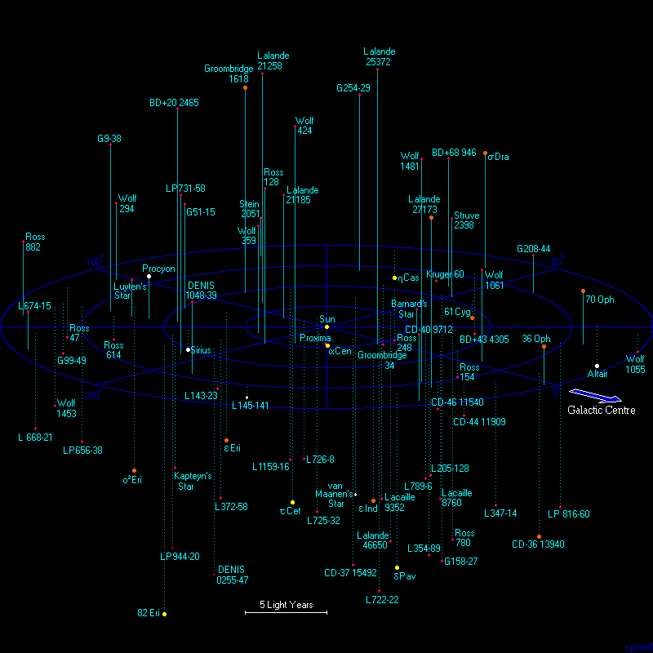
Stars within 20 light years of the Sun

Slide 26
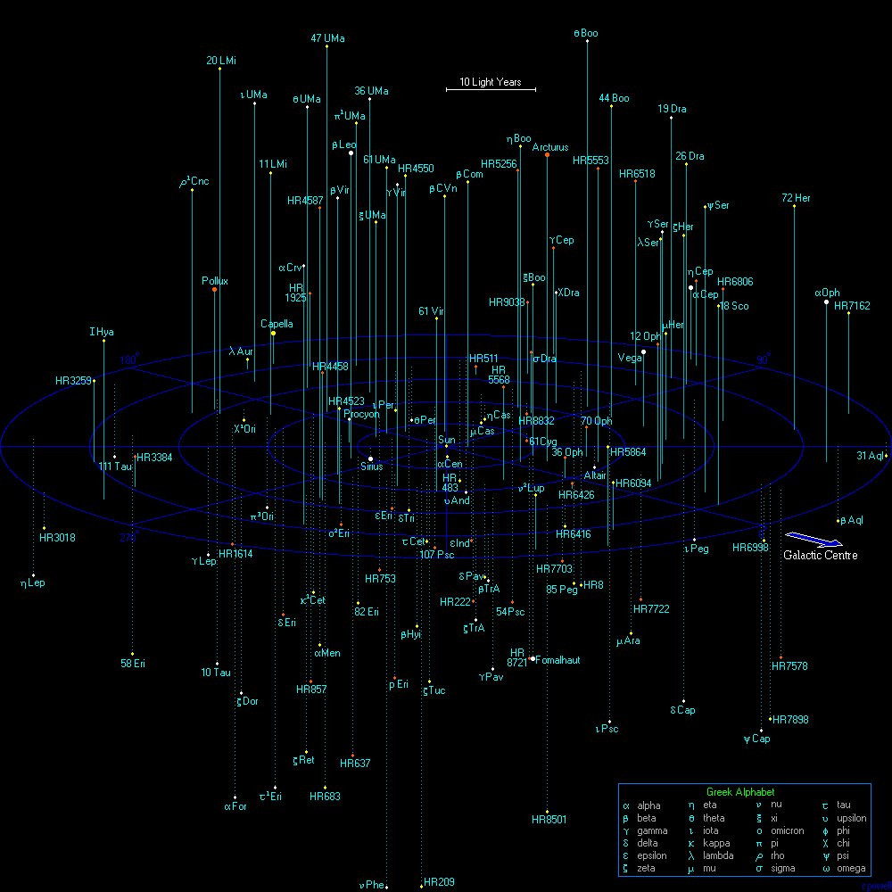
Stars within 50 light years of the Sun

Slide 27
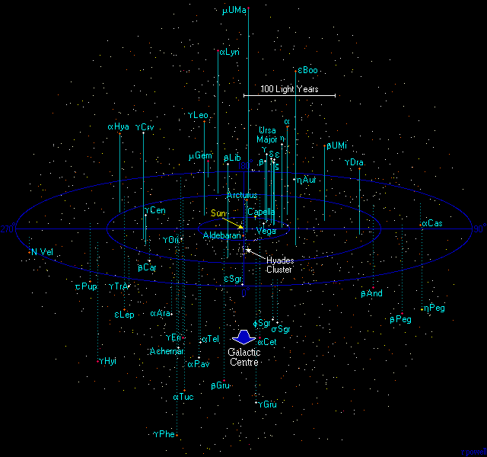
Stars within 250 light years of the Sun

Slide 28
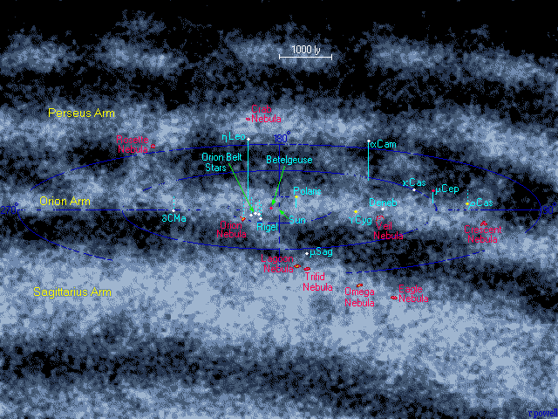
Stars within 5000 light years of the Sun

Slide 29
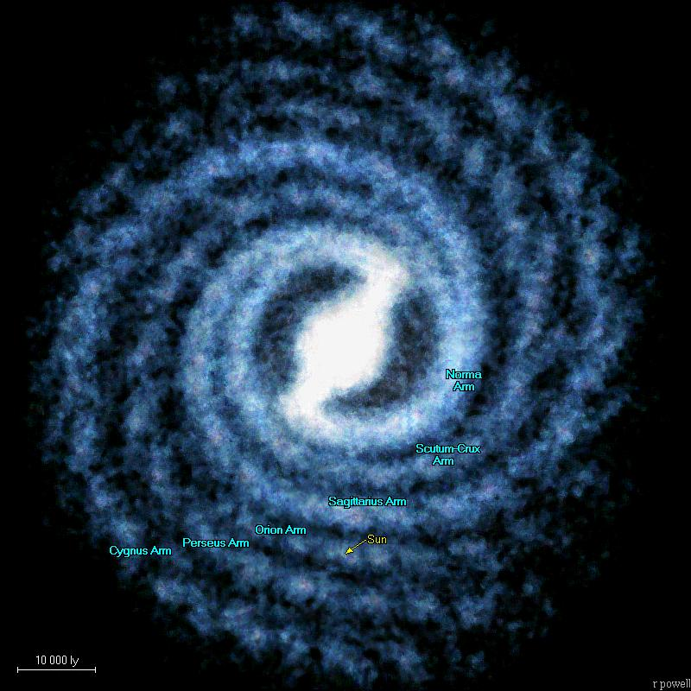
Milky Way

Slide 30
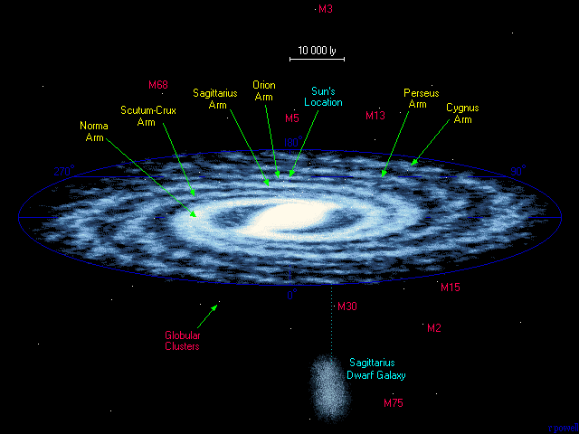

Slide 31
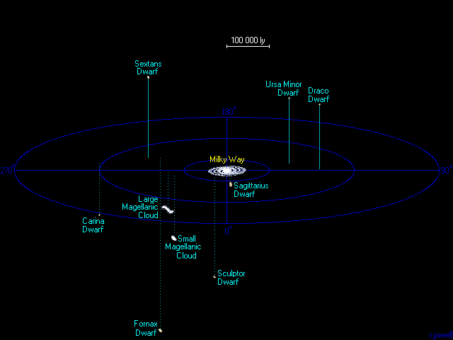

Slide 32
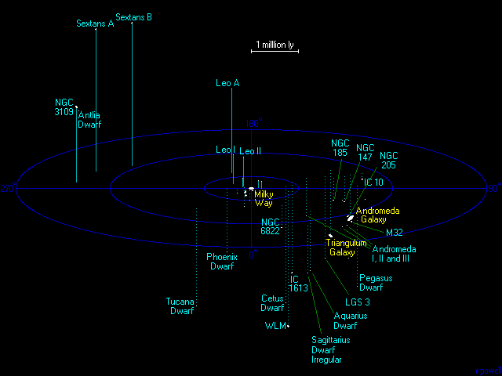
The Local Group of galaxies

Slide 33
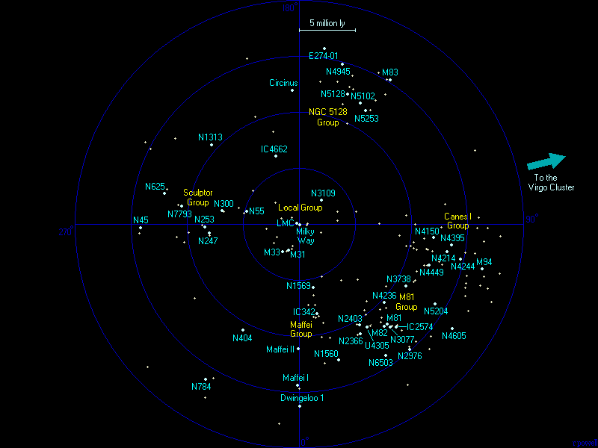

Slide 34
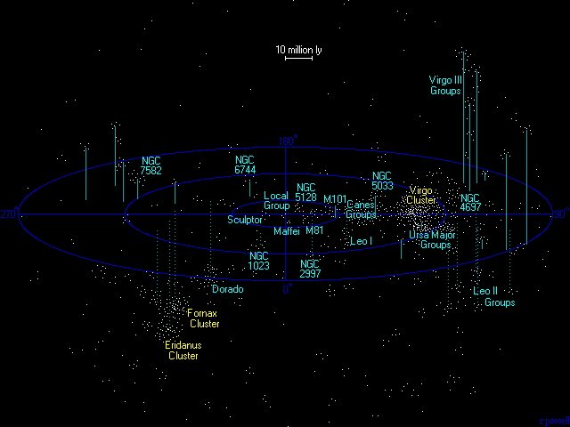
The Virgo Cluster

Slide 35
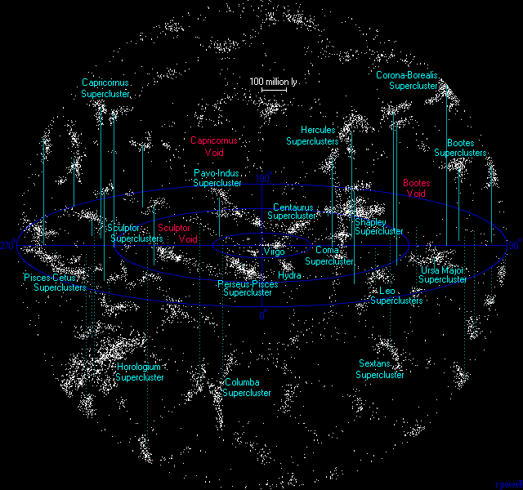
Superclusters

Slide 36
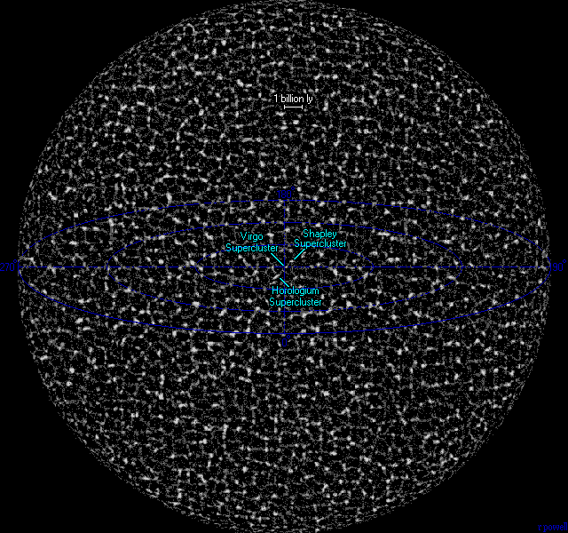
The Universe

Slide 37
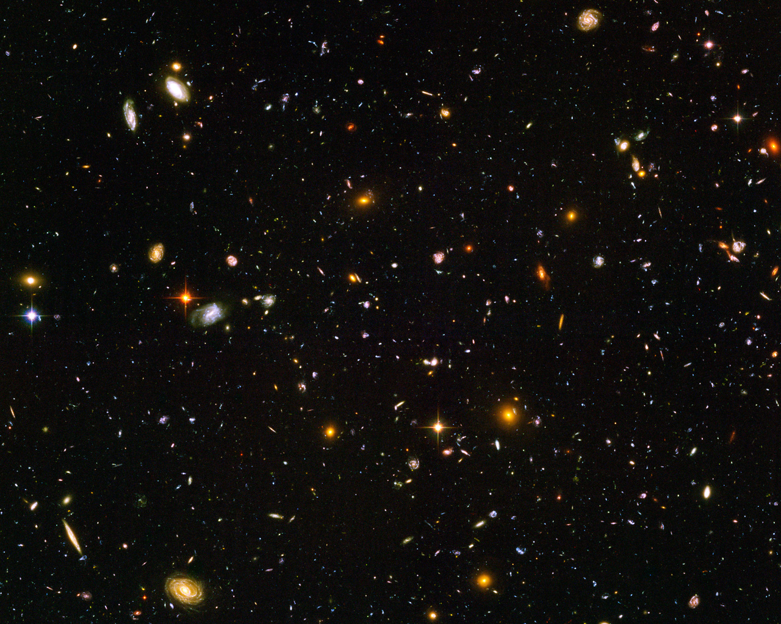

Slide 38
Psalm 19:1-6
1 The heavens declare the glory of God; the skies proclaim the work of his hands.

Slide 39
Fine Tuning
Λ – cosmological constant
Q – lumpiness of the Universe
Resonance in carbon and oxygen nuclei
Gravitational constant just right
Ω – density parameter
ratio of gravity to electromagnetic force
Strength of strong nuclear force
Ratio of electron mass to proton mass
Ratio of neutron mass to proton mass
Flatness of the Universe
Polarity of water molecule
Initial Entropy of Universe
+ dozens of other parameters
Link to Video

Slide 40
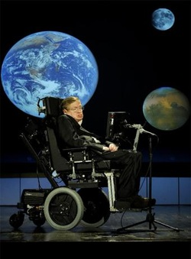
Stephen Hawking
Director of research at the centre for physical cosmology, University of Cambridge.
"The remarkable fact is that the values of these numbers seem to have been very finely adjusted to make possible the development of life”
“M-theory doesn’t disprove God, but it makes him unnecessary. It predicts that a universe will be spontaneously created out of nothing, without the need for a creator.”

Slide 41
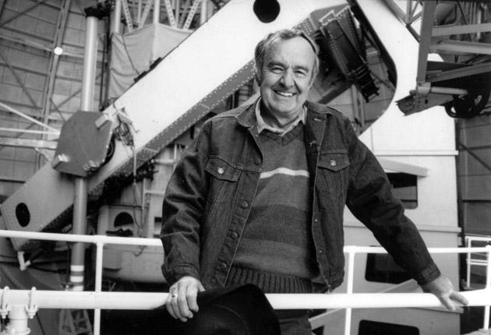
Allan Sandage – American Astronomer and Physical Cosmologist
“It was my science that drove me to the conclusion that the world is much more complicated than can be explained by science. It is only through the supernatural that I can understand the mystery of existence.”
Notes:
Worked alongside Edwin Hubble and within the field was known as one of the most influential astronomers of the 20th century. Became a Christian at the age of 50 based on the evidence from what he observed.

Slide 42
God of the Gaps
Look, we’ve just figured out how DNA works! ... What an amazing design!
Look, we’ve just figured out how DNA works! ... We don’t need any myths to explain it anymore.

Slide 43
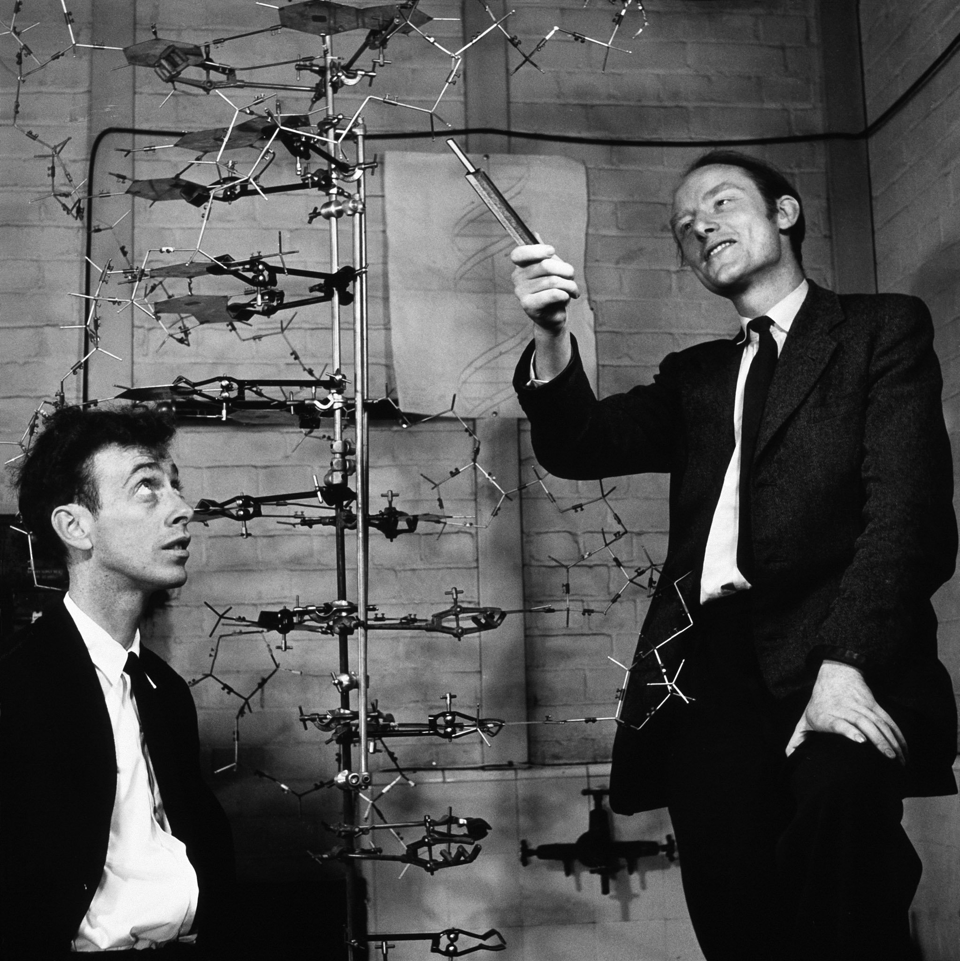
Francis Crick
“Biologists must constantly keep in mind that what they see was not designed, but rather evolved.”
Francis Crick
James Watson
'The origin of life seems almost to be a miracle, so many are the difficulties of its occurring
Francis Crick

Slide 44
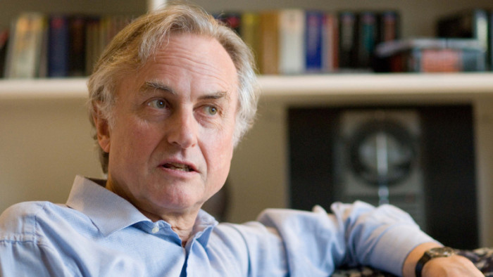
Richard Dawkins – Oxford Biologist and author of “The God Delusion”
“Biology is the study of complicated things that have the appearance of having been designed with a purpose.”
Notes:
Richard Dawkins – prominent atheist
On a mission to remove all religion from the world

Slide 45
More DNA videos
DNA unzipped
Transcription (reading of the genetic message)
Translation (turning the message into proteins)

Slide 46
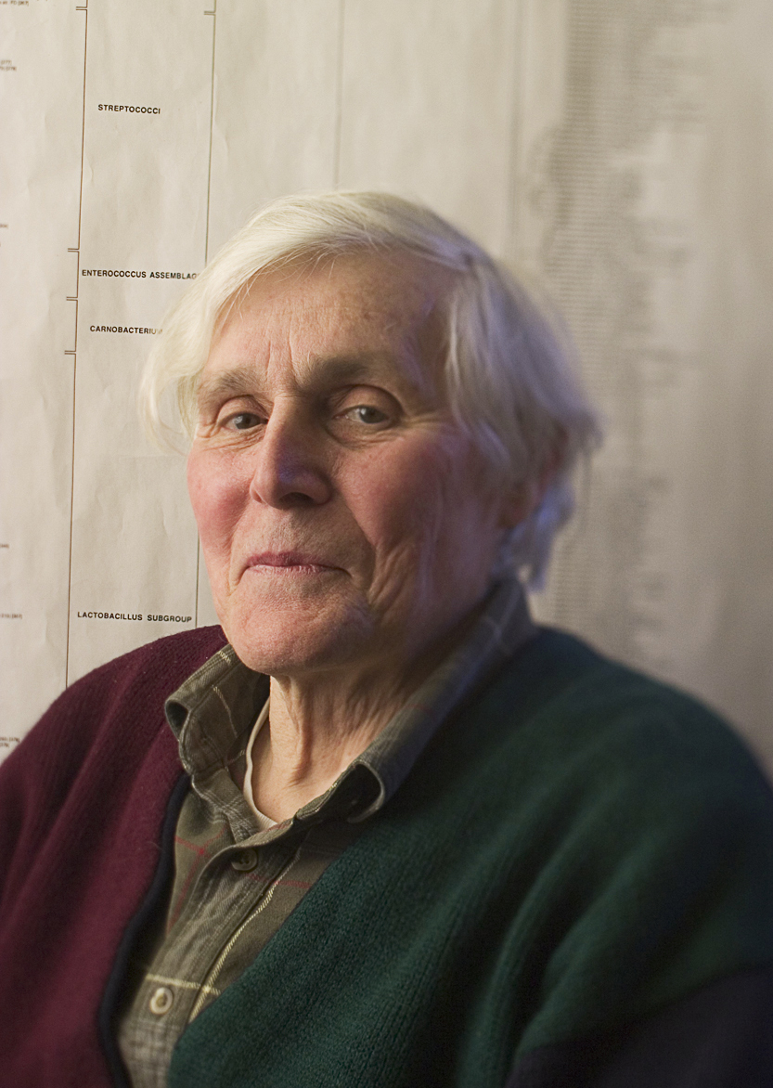
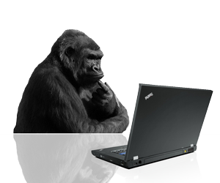
Carl Woese – American Microbiologist
The chances for the spontaneous assembly of a replicator in the pool I described above [DNA from randomness] can be compared to those of the gorilla composing, in English, a coherent recipe for the preparation of chili con carne.
Notes:
Picture a gorilla (very long arms are needed) at an immense keyboard connected to a word processor. The keyboard contains not only the symbols used in English and European languages but also a huge excess drawn from every other known language and all of the symbol sets stored in a typical computer.

Slide 47
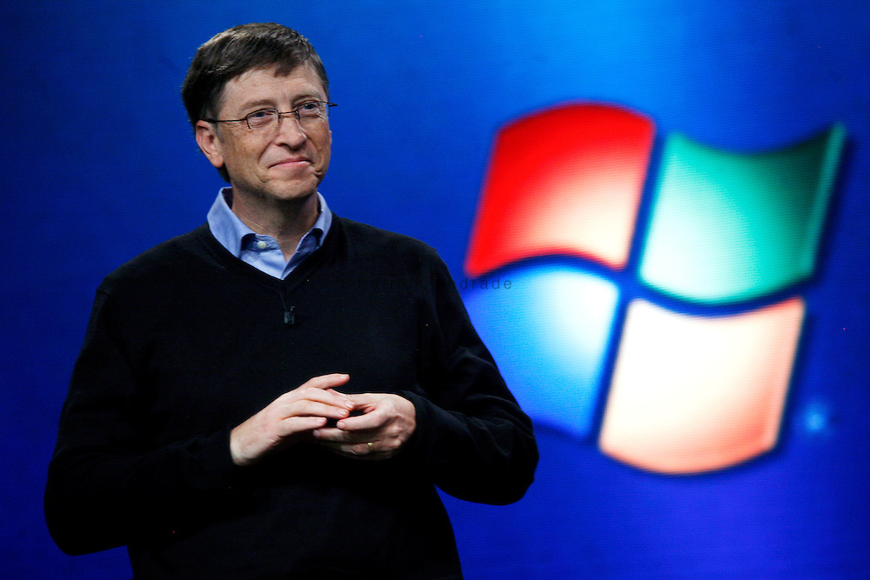
Bill Gates – Founder of Microsoft
“DNA is like a computer program but far, far more advanced than any software ever created.”
Notes:
It’s not just the mechanism it’s the language – it is a very complex language.
The mechanisms and language of DNA is the same from the most simple microbes to the most complicated things like us.

Slide 48
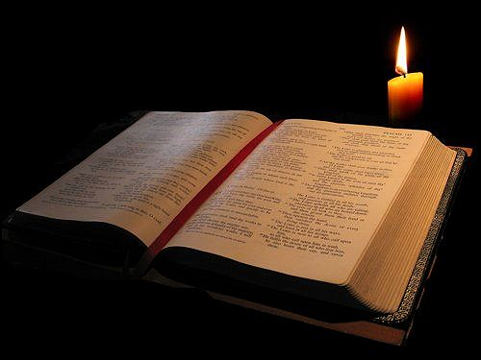
Romans 1:20
20 For since the creation of the world God’s invisible qualities—his eternal power and divine nature—have been clearly seen, being understood from what has been made, so that people are without excuse.

Slide 49
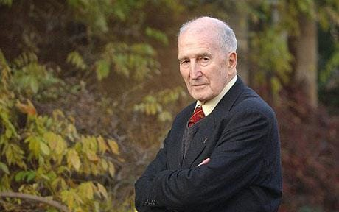
Antony Flew – English Philosopher and prominent athiest
“I now believe there is a God...I now think it [the evidence] does point to a creative Intelligence almost entirely because of the DNA investigations. “
There is a God - 2007
Notes:
At the age of 81 he shifted his position from atheism to theism

Slide 50
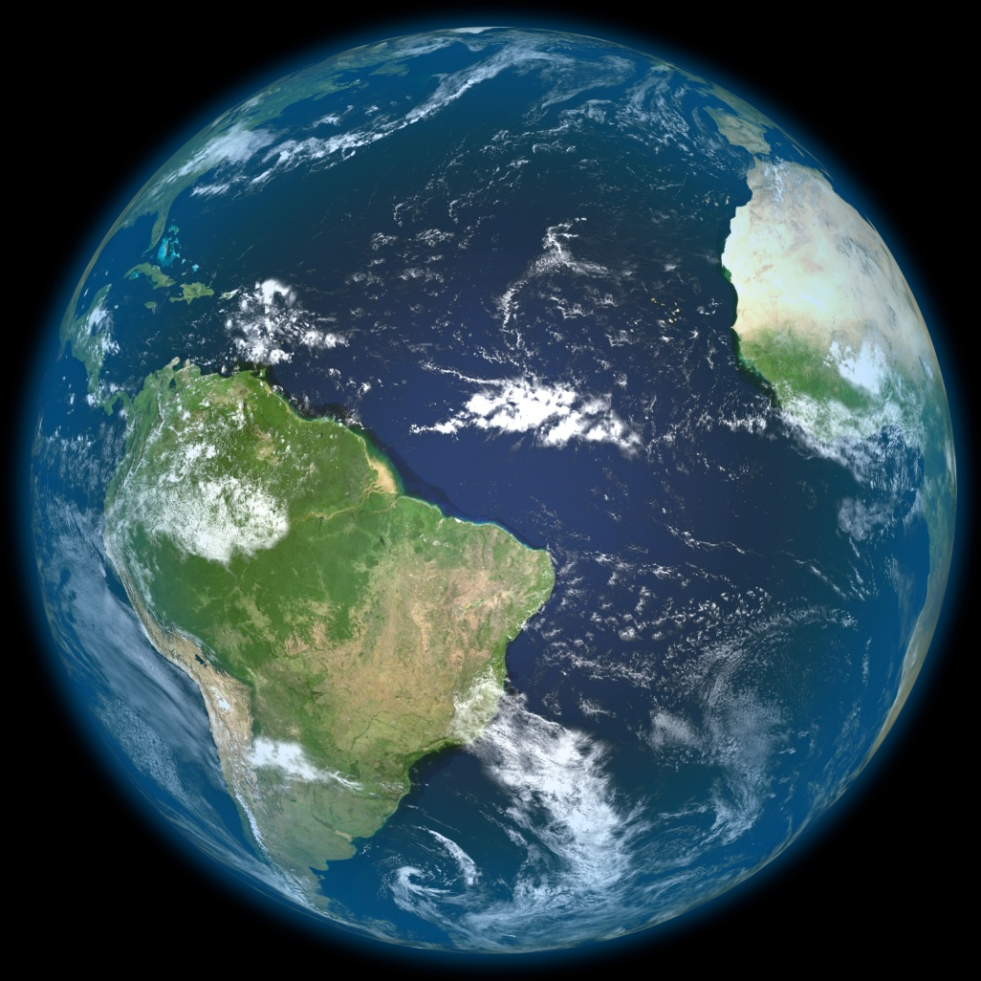
Did God simply wind up the Universe and let it run its course?

Slide 52
Colossians 1:15-17
15 He is the image of the invisible God, the firstborn over all creation. 16 For by him all things were created: things in heaven and on earth, visible and invisible, whether thrones or powers or rulers or authorities; all things were created by him and for him. 17 He is before all things, and in him all things hold together.

Slide 53
Colossians 1:15-17
15 He is the image of the invisible God, the firstborn over all creation. 16 For by him all things were created: things in heaven and on earth, visible and invisible, whether thrones or powers or rulers or authorities; all things were created by him and for him. 17 He is before all things, and in him all things hold together.

Slide 54
Purpose

Slide 55
Science alone

Slide 56
Genesis 1:27
27 So God created mankind in his own image,
in the image of God he created them;
male and female he created them.

Slide 57
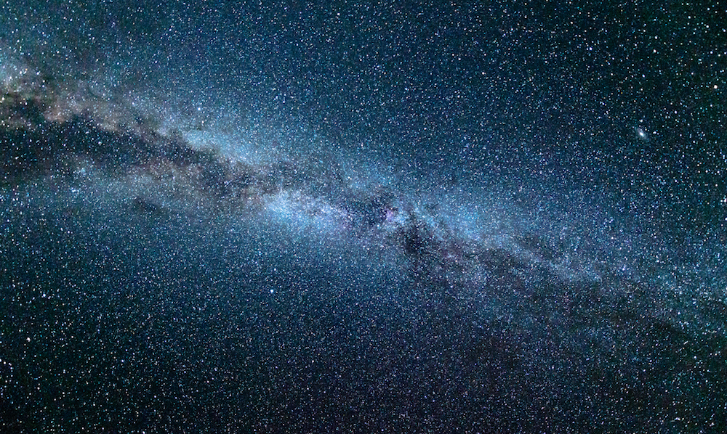
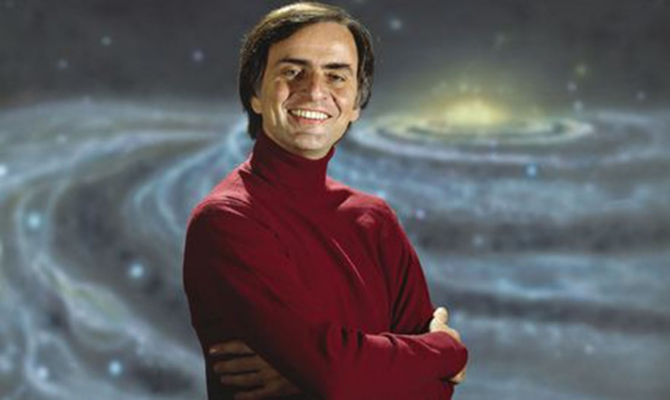
Carl Sagan
Holy, holy, holy
is the Lord God Almighty,
who was, and is, and is to come.
Revelation 4:8
The cosmos is all that is, or ever was, or ever will be.

